Slide 1
Engine Cycles
Module – 2
Theoretical Engine Cycles and Actual Cycle
Prof. Amitava Datta
Jadavpur University
Power Engineering Department

Slide 2
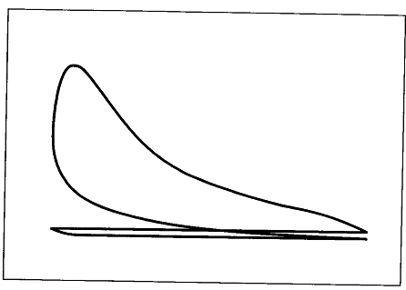

Engine working cycle
Volume, V
Indicator diagram of an engine shows the variation of pressure with volume in the engine cylinder. We have already learnt from the previous section that the net area of the indicator diagram denotes the indicated work done on the piston.
Considering the engine to be a heat engine, this work is continuously developed in every working cycle of the engine along with necessary heat exchange. From the second law of thermodynamics, there needs to be a heat supply from a source and heat rejection to sink. In the actual engine, the heat supply is due to the burning of the fuel in the engine cylinder in every cycle; and the heat rejection is the heat given away to the environment through hot exhaust gas, heat lost to engine coolant and any radiation loss from the hot engine body to the surrounding.

Slide 3
Theoretical Engine Cycles
To make the engine analysis simple, some thermodynamic cycles have been defined which are specific to particular types of engines. The thermodynamic cycles are based on certain assumptions which deviate these cycles from the actual cycle. Thus the actual performance of the engine do not match with the performance from the theoretical cycles. For example, actual thermal efficiency will be lower than that calculated from the theoretical cycles.
Still, theoretical cycle analysis finds importance, because –
It is simple to make theoretical cycle analysis
The qualitative variation in the performance parameters from the theoretical analysis is the same as in actual practice due to variation in input parameters. For example, if the theoretical cycle of S.I.Engine, shows an increase in thermal efficiency with the increase in compression ratio, then in the actual engine also the increase in compression ratio will result in an increase in thermal efficiency. The quantitative change may be different, but qualitatively the nature of variation will remain the same.

Slide 4
Types of Theoretical Engine Cycle
Air Standard Cycle
Most idealized
Air Cycle
Fuel-Air Cycle
Actual Cycle
Practical

Slide 5
Air Standard Cycles
Assumptions –
Air is the working medium whose mass and composition are considered to remain the same over the entire cycle.
The working fluid (air) is a perfect gas and has constant specific heat.
The actual open cycle of the engine (where gas exchange occurs) is changed into a closed cycle assuming that the gases being exhausted are fed back during the intake process.
The compression and expansion processes are isentropic
The heat addition is simulated by heat transfer from a constant temperature reservoir.
Heat loss through the exhaust is also simulated as heat rejection to a sink at low temperature.
All processes are considered to be internally reversible.
The exhaust and intake processes are assumed to occur at constant pressure and cancel each other thermodynamically. So the air standard cycles consist of compression, heat addition, expansion and heat rejection processes.

Slide 6
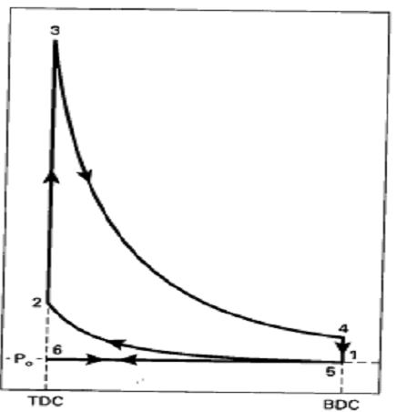
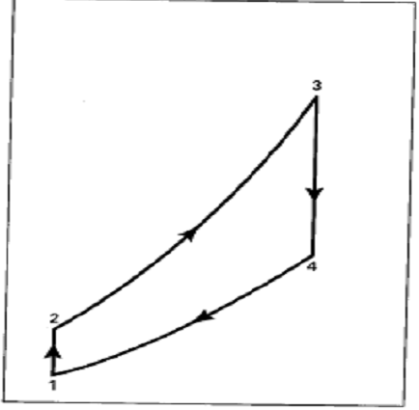


Otto Cycle
Const. volume
isentropic
isentropic
Const. volume
p_{atm}
Specific volume, v
Specific entropy, s
Exhaust process 5 – 6 and intake process 6 – 1, both at constant pressure cancel each other. So they are not accounted in the analysis. State 5 and 1 are considered same.
Processes –
1 – 2 : Isentropic compression
2 – 3 : Constant volume heat addition
3 – 4 : Isentropic expansion
4 – 5 : Constant volume heat rejection
Thus the closed cycle 1 – 2 – 3 – 4 – 1 is the cycle under consideration

Slide 7
Otto cycle is the air standard cycle for S.I.Engine – why?
In Otto cycle, the heat addition process, simulating combustion of fuel, is at constant volume.
In S.I.Engine, a homogeneous fuel air mixture is taken in during suction. The mixture is then compressed during the compression stroke, when the air and fuel further mixes inside the cylinder. The ignition by spark is given near the end of the compression stroke. The resulting flame front travels through the fuel-air mixture as a premixed flame. The flow and thermodynamic conditions within the cylinder results in a very high burning velocity of the flame. So, the flame travels very fast and completes the combustion within a few degrees of crank rotation. Under the ideal condition of the air standard cycle, this process is assumed to be infinitely fast and the heat addition is assumed as constant volume.
Significance of Constant Volume Heat Rejection in the Air Standard Cycle
In the actual engine, exhaust valve opens near the end of the expansion stroke. The pressure inside the cylinder remains higher than atmospheric pressure at that time. As a result, a large mass of gas flows out very fast carrying out a significant fraction of rejected heat. This is called blow down. The constant volume heat rejection ideally simulates the heat rejection in the open engine system due to blow down.

Slide 8
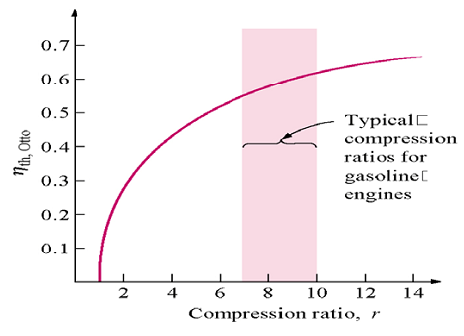
Performance Parameters of Otto Cycle
Compression ratio r = v₁/v₂
Pressure ratio r_{p} = p₃/p₂ = p₄/p₁
Work output
= 1 −
1
, γ = c_{p}/c_{v}=1.4 for air
Thermal efficiency η_{th} =
r ^{γ -1}
Heat input
r p₁
(r_{p}-1) (r^{γ-1} -1)
Mean effective pressure =
γ -1
(r-1)
Thermal efficiency of Otto cycle is a function of compression ratio alone, as γ is a constant in the air standard cycle analysis.
Note that with the increase in compression ratio, the thermal efficiency of Otto cycle increases. But the relative increment decreases as the compression ratio becomes higher. In practical S.I. engine, the compression ratio is limited by abnormal combustion or detonation in the engine cylinder.
Also note that, MEP increases with the increase in p₁, i.e. pressure at the beginning of compression stroke. This justifies the benefit of supercharging.

Slide 9
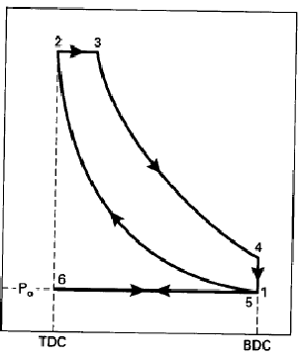
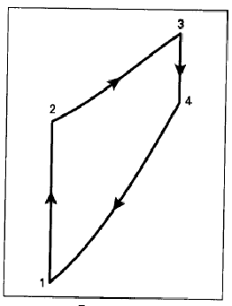


Diesel Cycle
Const. pressure
isentropic
isentropic
Const. volume
Specific volume, v
Specific entropy, s
Exhaust process 5 – 6 and intake process 6 – 1, both at constant pressure cancel each other. So they are not accounted in the analysis. State 5 and 1 are considered same.
Processes –
1 – 2 : Isentropic compression
2 – 3 : Constant pressure heat addition
3 – 4 : Isentropic expansion
4 – 5 : Constant volume heat rejection
Thus the closed cycle 1 – 2 – 3 – 4 – 1 is the cycle under consideration

Slide 10
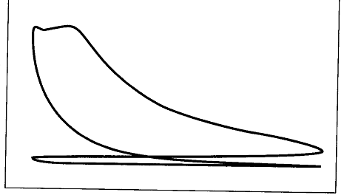
Significance of Diesel cycle as the theoretical cycle of C.I.Engine
In diesel cycle, the heat addition is at constant pressure after the isentropic compression process.
In a C.I.Engine (diesel engine), only air is admitted during the suction stroke. Air is compressed during compression, when its temperature along with pressure increase. Near the end of compression, the fuel injection starts in the high temperature air within the cylinder. After a short delay following the start of injection, the fuel ignites automatically by its own due to the high air temperature existing in the cylinder. The resultant heat release increases the temperature and tends to increase the pressure. But as the combustion proceeds over a certain duration along with the injection of fuel, the pressure cannot increase much, rather it remains nearly constant due to the expansion (volume increase), which has also started by the time. Thus constant pressure heat addition simulates the combustion in diesel engine. See the actual cycle of diesel engine
p
v

Slide 11
Performance Parameters of Diesel Cycle
Compression ratio r = v₁/v₂
Cut off ratio r_{c} = v₃/v₂
Work output
= 1 −
1
(r_{c})^{γ}-1
Thermal efficiency η_{th} =
Heat input
r ^{γ -1}
γ (r_{c}-1)
Since the blue part of the efficiency term is always greater than 1, the thermal efficiency of Diesel cycle will be less than that of Otto cycle for the same compression ratio. But in actual practice, the compression ratio of diesel engine is much higher than that of gasoline engine.
r p₁
[ γ r^{γ-1}(r_{c}-1) − {(r_{c})^{γ} -1}]
Mean effective pressure =
γ -1
(r-1)
Remember that the cut off ratio (r_{c}) is not a natural choice of independent variable. It is rather dependent on the heat input Q_{in} as follows.
γ -1
Q_{in}
r_{c}= 1 −
γ r^{γ-1}
p₁ V₁

Slide 12
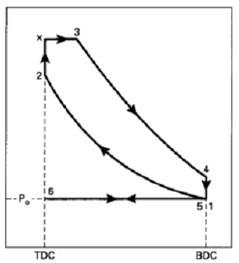
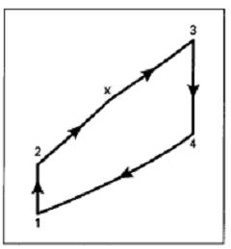


Dual Cycle or Limited Pressure Cycle
Const p
Const V
Specific volume, v
Specific entropy, v
Processes –
1 – 2 : Isentropic compression
2 – x : Constant volume hear addition
x – 3 : Constant pressure heat addition
3 – 4 : Isentropic expansion
4 – 5 : Constant volume heat rejection
First part of the heat added is at constant volume and the second part is at constant pressure.

Slide 13
For which type of I.C. Engine is dual cycle the air standard cycle?
Dual cycle is the air standard cycle for high speed compression ignition engine or high speed diesel engine.
In a diesel engine, fuel injection in the engine cylinder starts near the end of compression stroke. The air temperature reaches relatively high value due to compression so that self ignition of fuel can occur. However, the ignition does not occur as soon the fuel injection starts. Ignition only takes place after a delay period (we will learn about ignition delay in detail later).
During the delay period, the fuel injection continues in the cylinder. The fuel is supplied to the engine cylinder by a fuel pump, driven by the engine only. When the engine speed is high, the fuel pump also rotates at high speed and injected comparatively large quantity of fuel during the delay period. This fuel gets accumulated in the engine. When ignition occurs after the delay period, the accumulated fuel burns very fast, resulting heat addition almost at constant volume. However, the fuel injection time is longer than the delay time. The fuel which is injected later on burns and releases heat almost at constant pressure (reason explained earlier). Thus for high speed diesel engine, a part of the heat addition is at constant volume and the remaining t constant pressure in the theoretical cycle.
In a low speed diesel engine, fuel injected during delay period is only very little. So the entire heat addition is almost at constant pressure.

Slide 14
Performance Parameters of Dual Cycle
Compression ratio r = v₁/v₂
Pressure ratio r_{p} = p_{x}/p₂
Cut off ratio r_{c} = V₃/V_{x}
Work output
= 1 −
1
r_{p}(r_{c})^{γ}-1
Thermal efficiency η_{th} =
Heat input
r ^{γ -1}
(r_{p}-1) + γ r_{p}(r_{c}-1)
r p₁
[ γ r_{p} r^{γ-1}(r_{c}-1) + r^{γ-1} (r_{p}-1)−{r_{p}(r_{c})^{γ} -1}]
Mean effective pressure =
γ -1
(r-1)

Slide 15
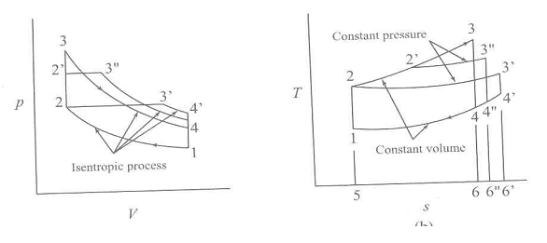
Comparison of Otto, Diesel and Dual Cycles
The cycles are compared in terms of their thermal efficiency based on certain compatible input conditions.
Same inlet conditions, compression ratio and heat input.
3
const. p
3
3’’
2’’
3’’
2’’
2
3’
p
2
3’
4’
T
4’
4’’
4
4’’
4
1
Isentropic
1
const. v
5
6
6’’
6’
v
s
Compression process 1-2 is same for all three cycles due to same CR.
Heat input at constant volume has larger slope in T-s plot than that at constant pressure. As the heat input is same, the process 2-3 for Otto cycle, and 2-3’ for Diesel cycle will be as shown in the T-s plot giving the same area under them, i.e. Area 2-3-6-5-2 = Area 2-3’-6’-5-2. Heat rejection line for all should fall on the same const. volume line. This indicates that the heat rejection in Diesel cycle is more than the heat rejection is in Otto cycle. Dual cycle come in between.
So., η_{Otto} > η_{Dual} > η_{Diesel}

Slide 16
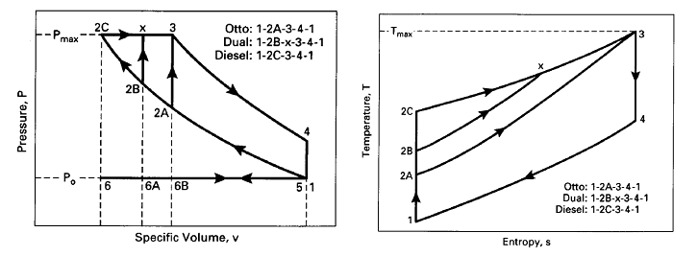
Same inlet condition, same peak pressure and same heat removal
Peak pressure in Otto cycle occurs at the end of heat addition, i.e. at pt. 3. To have the same peak pressure, the constant volume heat addition in Diesel cycle should occur at this pressure. Thus pt 3 will be the same for all three cycles. The p-v and T-s diagrams are drawn accordingly. From the T-s diagram, the heat rejection is the same for all three cycles. While, heat addition is the maximum in Diesel, then Dual and minimum in Otto.
So, η_{Diesel} > η_{Dual} > η_{Otto}
Try a similar analysis for same inlet condition, same compression ratio and same heat rejection.

Slide 17
Summary of comparison
Conditions | Relative Performance
Same inlet condition, CR, heat input | η_{Otto} > η_{Dual} > η_{Diesel}
Same inlet condition, CR, heat rejection | η_{Otto} > η_{Dual} > η_{Diesel}
Same inlet condition, peak pressure, heat input | η_{Diesel} > η_{Dual} > η_{Otto}
Same inlet condition, peak pressure, heat rejection | η_{Diesel} > η_{Dual} > η_{Otto}
Same inlet condition, peak pressure, work output | η_{Diesel} > η_{Dual} > η_{Otto}

Slide 18
Air Cycle
Air cycle analysis retains all the assumptions of air standard cycle except that of constant specific heat of air.
For all gases, except monatomic ones, the specific heat increases with the increase in temperature. The dependence can be expressed by a polynomial equation in temperature as,
c_{p} = a + bT + cT² + dT³
The accuracy of predicting the specific heat value depends upon the order of the polynomial equation.
c_{v} = c_{p} – R, where R is the specific gas constant
Ratio of specific heat, γ = c_{p}/c_{v} = 1+(R/c_{v})
Effect of variation in specific heat
T c_{v} γ
The variation of specific heat of air with temperature is considered in air cycle analysis

Slide 19
Effect of variation in specific heat on the p-V diagram
Take Otto cycle
1-2-3-4 : Air standard cycle with const. sp. Heat
1-2’-3’-4’ : Air cycle with variable sp. heat
3
1. During the compression process, p₂=p₁ r^{γ}, where r = compression ratio. As with the compression of air, temperature increases, so γ decreases. Thus the final pressure at the end of compression decreases, and p_{2’} becomes less than p_{2.}
3’
p
2
2’
4
4’
2. During heat addition, temperature increases. So c_{v} also increases.
Q_{in} = m c_{v} (T₃−T₂). As, c_{v} increases with temperature, the temperature rise decreases for the same Q_{in}. So. T_{3’} becomes much lower than T₃, accordingly p_{3’} becomes lower than p₃
1
v
3. During expansion, as temperature decreases, c_{v} increases, and p_{4’} gets changed accordingly.
Overall, due to variation in specific heat, the area under the p-v diagram decreases, so, net work output decreases for the same heat input. As a result, thermal efficiency also decreases.

Slide 20
Fuel-air cycle
Fuel-air cycle represents the closest theoretical approximation to the actual engine cycle. The thermal efficiency of the actual engine normally lies around 85% of that calculated from the fuel-air cycle.
The analysis of the fuel-air cycle considers the following points.
The actual composition of cylinder comprises a mixture of fuel vapour, air and residual gas from the previous cycle considered at the beginning of the compression stoke.
Gas properties are calculated as the properties of gas mixture. Variation of specific heat with temperature and concentration is considered.
No chemical change in the mixture is considered prior to combustion. Combustion and heat release are considered as instantaneous, i.e. at constant volume, for Otto cycle and at constant pressure for diesel cycle.
Subsequent to combustion, the mixture is always at chemical equilibrium with dissociation of the combustion products, like CO₂ and H₂O.
Compression and expansion are isentropic and no heat exchange occurs between the gases and the cylinder walls
The change in number of moles accounted during the chemical change of combustion to calculate the pressure and temperature
The movement of charge within the engine cylinder is neglected.

Slide 21
Effect of Dissociation
1-2-3-4 : Air standard cycle with const. sp. Heat
1-2’-3’-4’ : Air cycle with variable sp. Heat
1-2’-3’’-4’’ : Fuel-Air cycle
3
Dissociation reactions are endothermic and reduce the maximum temperature T_{3”} at the end of heat addition process. As a result the pressure p_{3’’} at the end of heat addition also decreases.
To find the pressure p_{3”} the variation of number of moles in the gas due to chemical reaction is to be considered.
(p_{3”}/p_{2’}) = (n_{3”} T_{3”})/(n_{2’}T_{2’})
3’
p
3’’
2
2’
4
4’
4’’
1
v
The effect of dissociation is much less than the effect of variable specific heat on the pressure and temperature at the end of heat addition process in Otto cycle.
Dissociation results in loss in work output as the area under the curve decreases. Thus the efficiency of the fuel-air cycle is less than that of air cycle.

Slide 22
Actual Cycle vs. Fuel-Air Cycle
Fuel-air cycle is the theoretical cycle closest to the actual cycle. The actual cycle differ from the fuel-air cycle due to the following factors.
Time loss factor
Heat loss factor
Incomplete combustion loss
Exhaust blow down loss
Pumping loss or gas exchange loss
Valve timing loss
Rubbing friction loss
3
p
2
4
6
5
1
v
In the figure above, the black cycle is the fuel-air cycle and the blue one is the actual cycle for a S.I.Engine. The difference between the two cycles is due to the factors mentioned above.
We will discuss the losses one by one in the subsequent slides.

Slide 23
Time Loss Factor
Time loss factor or burning time loss is the loss caused due to the finite time of combustion of fuel in the engine cylinder with the progression of the flame.
In theoretical fuel-air cycle, heat addition due to combustion is assumed to be instantaneous. In actual S.I. engine, though the flame travels very fast, it requires a finite time to complete combustion of all the fuel.
The spark is given at point a, the pressure start to rise following the spark. The combustion does not get completed when the TDC is reached.
3
c
Isentropic expansion line
p
b
2
4
a
6
5
1
v
As the piston starts to travel back towards BDC, the maximum pressure is reached at c, when the combustion is completed. The red area denotes the loss of work due to finite time of combustion and is called time loss factor.
This loss is also known as progressive combustion loss.

Slide 24
Heat loss Factor and Incomplete Combustion loss
3
Heat loss factor is the loss of energy in the form of heat transfer from the hot gas inside the engine to the coolant circulated around the engine.
The green area denotes this loss in the actual engine cycle in comparison to the theoretical fuel-air cycle.
c
Isentropic expansion line
p
b
2
4
a
6
5
1
v
Incomplete combustion loss is the loss of work due to incomplete combustion of fuel. Incomplete combustion will lead to less release of heat in the engine cylinder. As a result, the peak pressure of the cycle will be less and the work output will be less. Incomplete combustion results in CO and UHC (unburnt hydrocarbon) in the exhaust. Incomplete combustion loss is less in C.I.engines than in S.I.engines.

Slide 25
Pumping loss or Gas exchange loss
3
In the theoretical fuel-air cycle, the exhaust and intake process lines are overlapping and cancel each other.
In the actual cycle, the pressure during the exhaust stroke is higher than atmospheric pressure as the exhaust gas is pushed out. On the other hand, during intake, the cylinder pressure is below atmospheric pressure creating suction.
c
p
b
2
4
a
6
Exhaust stroke
5
p_{atm}
Pumping loss
Intake stroke
1
v
The difference in pressure during exhaust and suction results in the negative loop (green area), which is subtracted from the positive loop (yellow area) to find the net work in a working cycle. The work loss in the negative loop is the pumping loss.

Slide 26
Exhaust Blow down loss
In the theoretical fuel-air cycle, the exhaust stroke 5-6 starts at BDC. But in the actual engine cycle, the exhaust begins before BDC, at point e, with the opening of the exhaust valve.
3
c
p
b
As a result, blow down begins at e and the cylinder pressure drops a little (pt. f instead of f ’) as the BDC is reached.
2
e
4
f '
a
f
p_{atm}
6
5
1
Due to this fall in pressure, the work given by the violet area is lost. This is called exhaust blow down loss.
v
However, if the exhaust valve is not opened in advance, the exhaust stroke would have started at point f’, and the exhaust process line would have continued as the dotted blue line. The pumping loss would have been much higher in that case due to higher pressure in the early part of exhaust stroke. Thus exhaust blow down loss helps to reduce the pumping loss and in the process increases the net work output from the cycle.

Slide 27
Valve Timing Loss
Valve timing loss is the loss of actual work in a working cycle due to improper timings of opening and closing of the intake and exhaust valves.
In the engine, fresh charge enters the engine cylinder through the intake valve at the beginning of each working cycle; the burned gas is exhausted through the exhaust valve at the end of the working cycle.
Ideally, in a four stroke engine, intake valve opens at TDC/IDC and closes at BDC/ODC; while exhaust valve opens at BDC/ODC in the following crank rotation and closes at TDC/IDC.
The engine valves are either operated mechanically using the cam and spring arrangement or electronically using a solenoid valve. Opening or closing of a valve refers to its movement over the valve lift distance. These movements are never instantaneous and takes place over a finite time. So, if the intake valve begins to open at TDC, it will open fully after a few degree crank rotation. Similarly, if the intake valve has to be closed completely at BDC, it must start closing a few degree crank rotation before BDC. These will reduce the actual admission of charge into the cylinder and lowers the work output from each cycle.
Therefore, one important criteria in maximizing the engine work output and minimize loss in each working cycle is to optimize the opening and closing times of the valves.

Slide 28
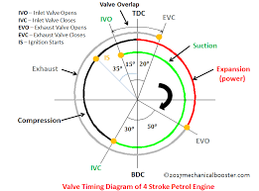
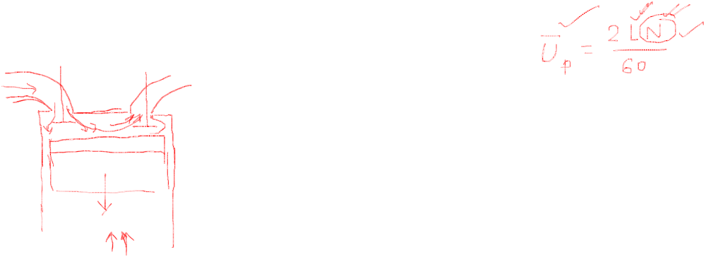
Valve Timing Diagram
IVO – Intake valve opens
IVC – Intake valve closes
EVO – Exhaust valve opens
EVC – Exhaust valve closes
Valve overlap
TDC
EVC
IVO
Suction
Spark
Exhaust
10°
10°
Expansion
(Power)
30°
Compression
30°
40°
EVO
IVC
BDC
Valve Timing Diagram for a Four Stroke S.I. Engine

Slide 29
Timings of the Intake Valve
Intake valve begins to open a few degree (10° – 15°) before TDC/IDC. This is done to allow the intake valve to open fully when the TDC is reached. A fully open valve ensures admission of charge without throttling or restriction, thus maximizes the charge admission into the cylinder.
Intake valve closes about 25° – 30° after BDC/ODC. This ensures additional charge admission into the cylinder following ram effect. When the fresh charge (either fuel-air mixture for S.I.engine or only air for C.I.engine) enters through the intake valve, it enters with some velocity depending upon the speed (RPM) of the engine (actually depending upon the piston speed). This gives some momentum to the air flow. As a result of this momentum, the charge continues to enter into the cylinder even when the piston reverses its motion and moves towards the TDC/IDC. However, as the pressure builds up in the cylinder with the movement of the piston, the charge admission reduces and finally the intake valve is to be closed to prevent reverse flow of charge. Thus, to admit more charge into the cylinder and increase the work output, the intake valve is closed after BDC/ODC. The phenomenon of admission of additional charge due to its momentum with the piston reversing back towards TDC/IDC is known as ram effect.
The closure of the intake valve is delayed for high RPM of the engine, as the charge velocity and therefore momentum is more.

Slide 30
Timings of the Exhaust Valve
The opening of the exhaust valve occurs before BDC/ODC. This results in the start of blow down from the cylinder even before the BDC/ODC is reached. As a result, the pressure inside the cylinder decreases at the beginning of the exhaust stroke from BDC. The early opening of the exhaust valve reduces the work done in the expansion stroke, in the form of exhaust blow down loss (explained before) . But it helps in increasing the net work output of the engine by reducing the pumping loss to a greater extent.
The closing of the exhaust valve occurs a few degrees after the TDC/IDC. Thus, there is a period of few crank angle degrees at the beginning of each working cycle, when both the intake valve and exhaust valve remain open. This is called valve overlap and it helps in scavenging and removal of residual gas from the previous cycle. The engine cylinder has a clearance volume, which will remain filled up with residual burned gas at the end of a working cycle. So, when the new working cycle begins, the residual gas mixes with the fresh charge and dilutes the charge. It also decreases the volume of charge that can be admitted into the cylinder. With the valve overlap, the fresh charge coming into the cylinder pushes some residual charge in the clearance volume to go out through the exhaust valve. This is called scavenging, which increases the amount of fresh charge entering into the cylinder and thus increases the work output.

Slide 31
Optimizing spark timing
In case of S.I. engine, an optimum spark timing and in case of C.I. engine an optimum fuel injection timing is required to maximize the work output.
3
Early spark timing
Optimum spark timing
Delayed spark timing
p
If the sparking is too much advanced, say at a, the pressure begins to rise fast during the compression stroke due to heat release in combustion. As a result work output decreases.
2
c
4
b
a
6
5
1
If the sparking is too much delayed, say at c, the peak pressure becomes lower and occurs further into the expansion stroke. Thus, the work output also decreases.
v
The maximum work output is obtained with the optimum location of spark timing, at b, which is about 20° before TDC/IDC
Similarly for C.I. engine, the fuel injection time is to be optimized for the maximum work output

Slide 32
Rubbing Friction Loss
Rubbing friction loss is due to friction between the piston and chamber walls, friction in various bearings and also includes the energy spent in operating various auxiliary equipment such as cooling fans, water pumps etc.
The piston ring friction increases rapidly with engine speed. It also increases to a small extent with increase in mean effective pressure. The bearing friction and the auxiliary friction also increase with engine speed.

Slide 33
Typical Losses in S.I. Engine
Item Compression Ratio = 8.0 | Load
 | Full Load | Half Load
A) Air standard cycle efficiency | 56.5%
I) Losses due to variation in specific heat and dissociation | 13% | 13%
II) Time loss / burning time loss | 4% | 4%
III) Incomplete combustion loss | 3% | 3%
IV) Direct heat loss | 4% | 5%
V) Exhaust blow down loss | 0.5% | 0.5%
VI) Pumping loss | 0.5% | 1.5%
VII) Rubbing friction loss | 3% | 6%
Fuel-air cycle efficiency (A-I) | 43.5% | 43.5%
Indicated thermal efficiency (A-I-II-III-IV-V-VI) | 31.5% | 29.5%
Brake thermal efficiency (A-I-II-III-IV-V-VI-VII) | 28.5% | 23.5%

Slide 34
Prob. A petrol engine having compression ratio of 6 uses a fuel with heating value of 40 MJ/kg. The air-fuel ratio is 15:1. Pressure and temperature at the start of compression stroke are 1 bar and 57°C, respectively. Determine the maximum pressure in the cylinder if the index of compression is 1.3 and the specific heat at constant volume is given by c_{v}=0.678+1.3×10⁻⁴T kJ/kg-K, where T is in K. Compare this value with that obtained when c_{v}=0.717 kJ/kg-K. Neglect any change in number of moles upon combustion.
Solution p₁=1 bar, T₁=57°C = 330 K, Compression ratio r = 6, γ = 1.3, HV=40000 kJ/kg
p₂ = p₁ r ^{γ} = 1×6^{1.3} = 10.27 bar; T₂ = T₁ r^{γ-1} = 330×6^{0.3} = 564.88 K
Considering 1 kg fuel,
1 × HV = (1+15) ʃ c_{v} dT ⇒ 1×40000 = 16 ʃ (0.678+1.3×10⁻⁴ T) dT
Solving, T₃ = 3260 K.
∴ p₃ = (T₃ / T₂) p₂ = (3260 / 564.88) × 10.27 = 59.27 bar
With constant specific heat,
40000 = 16 × 0.717 × (T₃ – T₂) ⇒ T₃ = 4052 K;
So, p₃ = (T₃ / T₂) p₂ = (4052 / 564.88) × 10.27 = 73.67 bar
T₃
T₃
T₂
564.88

